Slide 1
EXCEPTION
CSI 211: OBJECT ORIENTED PROGRAMMING
Tanjina Helaly

Slide 2
WHAT IS EXCEPTION
An exception is an abnormal condition that arises in a code sequence at run time.
In other words, an exception is a runtime error.
In computer languages that do not support exception handling, errors must be checked and handled manually—typically through the use of error codes, and so on.

Slide 3
WHAT IS EXCEPTION
Definition: An exception is an event, which occurs during the execution of a program, that disrupts the normal flow of the program's instructions.
Following are some scenarios where an exception occurs.
  A user has entered an invalid data.
  A file that needs to be opened cannot be found.
  A network connection has been lost in the middle of communications or the JVM has run out of memory.

Slide 4
HOW DOES IT OCCUR?
a) Implicitly by some error condition – (system generated exception)
  class ImplicitlyRaisedException{
    public static void main( String[] arguments ){
      int students[] = new int[5];
      students[ 10 ] = 1; // Exception occurs here
    }
  }
b) Explicitly by the Programmer
  class ExplicitlyRaisedException{
    public static void main( String[] arguments ){
    throw new ArrayIndexOutOfBoundsException();
    }
  }

Slide 5
FEW MORE EXAMPLES
Example Method call | exception
scan.nextInt() – for any nonInteger input | InputMismatchException
Integer.parseInt(“abc”) | NumberFormatExcpetion
2/0 | ArithmeticException
new FileReader(“C:\\temp.txt”) Or new FileWriter(“C:\\temp.txt”) | FileNotFoundException
obj.read() or obj.write() - obj is any IO related object | IOException

Slide 6
EXCEPTION KEYWORDS
try
catch
finally
throw
throws

Slide 7
HOW TO HANDLE EXCEPTION
Using try-catch-finally block
  Program statements that you want to monitor for exceptions are contained within a try block.
    If an exception occurs within the try block, it is thrown.
  Programmer code can catch this exception (using catch) and handle it in some rational manner.
  Any code that absolutely must be executed after a try block completes is put in a finally block.

Slide 8
FLOW CONTROL IN TRY-CATCH BLOCKS
When you call a risky method, one of two things can happen.
  The risky method either succeeds, and the try block completes,
  or the risky method throws an exception back to your calling method.
If the try block fails (throws an exception),
  flow control immediately moves to the catch block without executing the rest of the code in try block..
  When the catch block completes, the finally block runs.
  When the finally block completes, the rest of the method continues on.

Slide 9
FLOW CONTROL IN TRY-CATCH BLOCKS
If the try block succeeds (no exception),
  flow control skips over the catch block and moves to the finally block.
  When the finally block completes, the rest of the method continues on.
If the try or catch block has a return statement, finally will still run
  Flow jumps lo the finally, then back to the return.
If the try or catch block has a throw statement and it is not handled, finally will still run
  Flow jumps lo the finally, then back to the throw.

Slide 10
HOW TO HANDLE EXCEPTION
This is the general form of an exception-handling block:
  try {
  // block of code to monitor for errors
  }
  catch (ExceptionType1 exOb) {
  // exception handler for ExceptionType1
  }
  catch (ExceptionType2 exOb) {
  // exception handler for ExceptionType2
  }
  // ...
  finally {
  // block of code to be executed after try block ends
  }
  Here, ExceptionType is the type of exception that has occurred.

Slide 11
EXAMPLE
class TestException {
  public static void main(String args[]) {
    int d, a;
    try { // monitor a block of code.
      d = 0;
      a = 42 / d;
      System.out.println("This will not be printed.");
    } catch (ArithmeticException e) { // catch divide-by-zero error System.out.println("Exception Message: "+e.getMessage());
    System.out.println("Division by zero.");
    }
    System.out.println("After catch statement.");
  }
}
This program generates the following output:
      Exception Message: / by zero
      Division by zero.
      After catch statement.

Slide 12
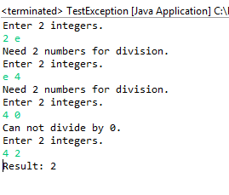
EXAMPLE – MULTIPLE CATCHES
import java.util .*;
public class TestException {
  public static void main(String[] args) {
    Scanner scan = new Scanner(System.in);
    boolean successful = false;
    while(!successful){
      System.out.println("Enter 2 integers.");
      try{
        int a = scan.nextInt();
        int b = Integer.parseInt(scan.nextLine().trim());
        int c = a/b;
        System.out.println("Result: " + c);
        successful = true;
      }
      catch(ArithmeticException e){
      System.out.println("Can not divide by 0.");
      }
      catch(InputMismatchException e){
        System.out.println("Need 2 numbers for division.");
        if (scan.hasNextLine())
        scan.nextLine();
      }
      catch(NumberFormatException e){
      System.out.println("Need 2 numbers for division.");
      }
    }
    scan.close();
  }
}

Slide 13
THROWS
If a method is
  capable of causing an exception that it does not handle,
  it must specify this behavior so that callers of the method can guard themselves against that exception.
This is done by including a throws clause in the method’s declaration.
A throws clause lists all types of exceptions that a method might throw.
This is necessary for all exceptions, except those of type Error or RuntimeException, or any of their subclasses.

Slide 14
THROW VS. THROWS
System-generated exceptions are automatically thrown by the Java runtime system. To manually throw an exception, use the keyword throw.
Any exception that is thrown out of a method must be specified as such by a throws clause.
Example
  Class TestException{
  public void throwException() throws Exception{
    throw new Exception();
    }
public void throwSystemException() throws InterruptedException {
Thread.sleep(100);
    }
  }

Slide 15
METHODS ARE STACKED
When you call a method, the method lands on the top of a call stack.
The method at the top of the slack is always the currently-running method for that stack
A method stays on the stack until the method hits its closing curly brace (which means the method's done).
If method main() calls method test(), method test() is stacked on top of method main()
Top of the stack
test()
main

Slide 16
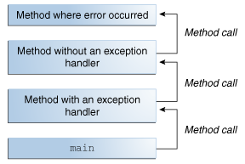
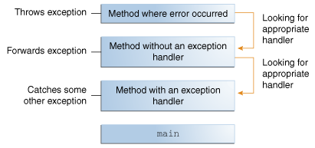
METHOD STACK AND EXCEPTION
Exception must be handled in one of the method in method stack.
Once an exception is handled, the program continues normal execution.
If you handle the same exception in multiple level only the closet one will be used to handle the exception.

Slide 17
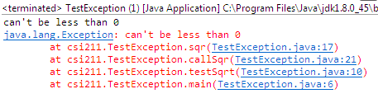
METHOD STACK AND EXCEPTION
public class TestException {
  public static void main(String[] args){
  testSqrt(-1);
  }
  public static void testSqrt(int s){
    try{
    System.out.println(callSqr(s));
    }catch(Exception e) {
    System.out.println(e.getMessage());
    e.printStackTrace();}
  }
  public static int sqr(int a) throws Exception{
    if (a < 0)
    throw new Exception("can't be less than 0");
    return a*a;
  }
  public static int callSqr(int a) throws Exception{
  return sqr(a);
  }
}
Output:

Slide 18
METHOD STACK AND EXCEPTION
public class TestException {
  public static void main(String[] args){
    testSqrt(-1);
  }
  public static void testSqrt(int s){
    try{
    System.out.println(sqr(s));
    }catch(Exception e) {
    System.out.println(e.getMessage());
    }
  }
  public static int sqr(int a) throws Exception{
    if (a < 0)
    throw new Exception("can't be less than 0");
    return a*a;
  }
  public static int callSqr(int a) throws Exception{
  return sqr(a);
  }
}
Stack
sqr
callSqr
testSqrt
main

Slide 19
METHOD STACK AND EXCEPTION
1
sqr
sqr throws an exception & doesn’t handle it.
The exception will be propagated to callSqr method.
callSqr
testSqrt
2
main
callSqr
callSqr doesn’t handle the exception. And
throws the exception to calling method testSrqt.
testSqrt
main
3
testSqrt
testSqrt handles the exception using try/catch
main
4
main
main completes the execution without any unusual error.

Slide 20
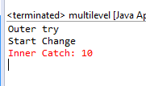
EXAMPLE - NESTED TRY CATCH
If you handle the same exception in multiple level only the closet one will be used to handle the exception.
public class multilevel {
  public static void main(String[] args) {
    int[] course = new int[10];
    try{
      System.out.println("Outer try");
      try{
        System.out.println( "Start Change" );
        course[ 10 ] = 1;
        System.out.println( "End Change" );
      } catch(ArrayIndexOutOfBoundsException e) {
      System.out.println( "Inner Catch: " + e.getMessage());
      }
    }catch (ArrayIndexOutOfBoundsException e) {
    System.out.println( "Outer Catch: " + e.getMessage());
    }
  }
}

Slide 21
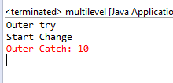
EXAMPLE - NESTED TRY CATCH
If an exception is not handled in inner level it can be handled by outer level.
public class multilevel {
  public static void main(String[] args) {
    int[] course = new int[10];
    try{
      System.out.println("Outer try");
      try{
        System.out.println( "Start Change" );
        course[ 10 ] = 1;
        System.out.println( "End Change" );
      } catch(NumberFormatException e) {
      System.out.println( "Inner Catch: " + e.getMessage());
      }
    }catch (ArrayIndexOutOfBoundsException e) {
    System.out.println( "Outer Catch: " + e.getMessage());
    }
  }
}

Slide 22

EXAMPLE-THROWING A DIFFERENT EXCEPTION
It is possible to throw a different exception after catching an exception.
If the try or catch block has a throw statement and it is not handled, finally will still run
  Flow jumps lo the finally, then back to the throw
public class TestFinally {
  public static void main(String[] args){
    try{
    test();
    }catch(Exception e){
    System.out.println("Catch from main: "+ e.getMessage());
  }}
  public static void test(){
    try{
    int c = 4/0; // system generated exception
    } catch(ArithmeticException e){
      System.out.println("Catch from test: "+ e.getMessage());
      throw new IllegalArgumentException("throwing another exception");
    } finally{
    System.out.println("Finally from test method."); }
    System.out.println(“After Finally from test method.");
    }}

Slide 23

EXAMPLE-THROWING A DIFFERENT EXCEPTION
It is possible to throw a different exception after catching an exception.
If the try or catch block has a throw statement and it is not handled, finally will still run
  Flow jumps lo the finally, then back to the throw
public class TestFinally {
  public static void main(String[] args){
    try{
    test();
    }catch(Exception e){
    System.out.println("Catch from main: "+ e.getMessage());
  }}
  public static void test(){
    try{
    throw new IllegalArgumentException("throwing another exception");
    } catch(ArithmeticException e){
    System.out.println("Catch from test: "+ e.getMessage());
    } finally{
    System.out.println("Finally from test method."); }
    System.out.println(“After Finally from test method.");
  }}

Slide 24

EXAMPLE-THROW AND CATCH EXCEPTION IN SAME BLOCK
public class TestFinally {
  public static void main(String[] args){
    try{
    test();
    }catch(Exception e){
    System.out.println("Catch from main: "+ e.getMessage());
    }
  }
  public static void test(){
    try{
    throw new ArithmeticException("throwing an exception");
    } catch(ArithmeticException e){
    System.out.println("Catch from test: "+ e.getMessage());
    } finally{
    System.out.println("Finally from test method.");
    }
    System.out.println(“After Finally from test method.");
  }
}

Slide 25
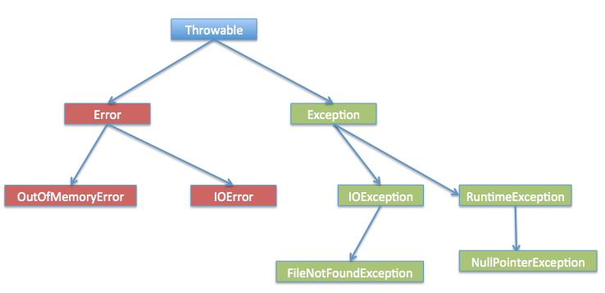
EXCEPTION HIERARCHY
All exception classes are subtypes of java.lang.Exception class.
2 useful methods:
getMessage()
printStackTrace()

Slide 26
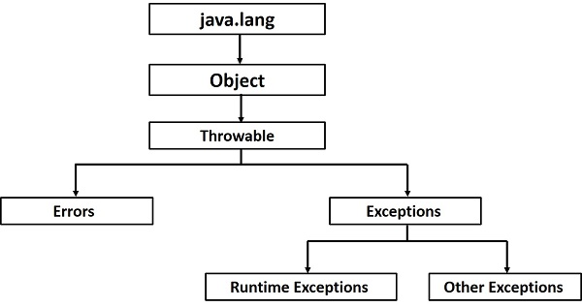
EXCEPTION HIERARCHY
All exception classes are subtypes of java.lang.Exception class.

Slide 27
TYPES OF EXCEPTION
2 types
  Checked
  Unchecked

Slide 28
CHECKED EXCEPTION
Checked exceptions are checked at compile-time.
It means if a method is throwing a checked exception then we cannot ignore at compile time
it should handle the exception using try-catch block or it should declare the exception using throws keyword,
otherwise the program will give a compilation error.
It is named as checked exception because these exceptions are checked at Compile time.

Slide 29
UNCHECKED EXCEPTION
Unchecked exceptions are not checked at compile time.
If a program is throwing an unchecked exception, the program won’t give a compilation error if you didn’t handle/declare that exception.
Most of the time these exceptions occur due to
  bad data provided by user during the user-program interaction.
  Logical error.
All Unchecked exceptions are direct sub classes of RuntimeException class.

Slide 30
ERROR
These are not exceptions at all, but problems that arise beyond the control of the user or the programmer.
Errors are typically ignored in your code because you can rarely do anything about an error.
For example, if a stack overflow occurs, an error will arise. They are also ignored at the time of compilation.

Slide 31
CATCHING SUBCLASS EXCEPTION
You can not catch the same exception twice at same level.
If a catch block is written to handle a super class exception, it will also catch subclass exception.
  try{
  }catch(Exception e){ // handle IOException as well
  }catch(IOException e) { // Compile error: Unreachable catch block for IOException. It is already handled by the catch block for Exception
  }
To handle the subclass separately, it must appear a catch block before the parent catch block
  try{
  }catch(IOException e){ //OK,
  }catch(Exception e) { // All exception except IOException will be cathed here
  }

Slide 32
USER DEFINED EXCEPTION

Slide 33
USER DEFINED EXCEPTION
Sometimes you may need to create your own exception.
How?
  just define a subclass of Exception (which is, of course, a subclass of Throwable).
  Your subclasses don’t need to actually implement anything—it is their existence in the type system that allows you to use them as exceptions.

Slide 34
USER DEFINED EXCEPTION
Exception class doesn’t have any method, only constructors.
  The most commonly used constructors are.
    Exception( )
    Exception(String msg)
Once you create the exception, you can throw and catch the exception as any other Exception.

Slide 35
EXAMPLE - USER DEFINED EXCEPTION
class SuperHeroException extends Exception {
  public SuperHeroException() {
  super();
  }
  public SuperHeroException(String message) {
  super(message);
  }
  public SuperHeroException(int energyLevel) {
  super("Energy level dropped below:" + energyLevel);
  }
}

Slide 36

EXAMPLE - USER DEFINED EXCEPTION
public class SuperHero {
  int energyLevel;
  public SuperHero(int a){
  energyLevel = a;
  }
  public void testEnergy() throws SuperHeroException {
    if(energyLevel < 50)
    throw new SuperHeroException(50);
  }
  public static void main(String[] args){
    SuperHero hero = new SuperHero(40);
    try{
    hero.testEnergy();
    }catch(SuperHeroException e){
    e.printStackTrace();
    }
  }
}
Output

Slide 37
EXAMPLE - USER DEFINED EXCEPTION
See the word doc for another example related to BankAccount

Slide 38
REFERENCE
Java: Complete Reference - Chapter 10
Java: How to Program – Chapter 11
Online Reference:
  http://www.tutorialspoint.com/java/java_exceptions.htm

